Slide 1

Energy Usage and Anomaly Analysis
Metergy Solutions
Daiki Sai
7/2/2025

Slide 2
Project Objectives
Metergy Solutions
1
2
3
Ingest and consolidate data from multiple JSON interval files
Clean and process data in Python, including timestamp formatting, null checks, and outlier detection
Identify missing data and days with incomplete or zero readings
4
5
6
Detect anomalies such as energy spikes, flatlined values, and abnormal usage patterns
Build a dashboard in Power BI to visualize trends and surface insights
Generate recommendations based on peak usage, outliers, and efficiency patterns

Slide 3
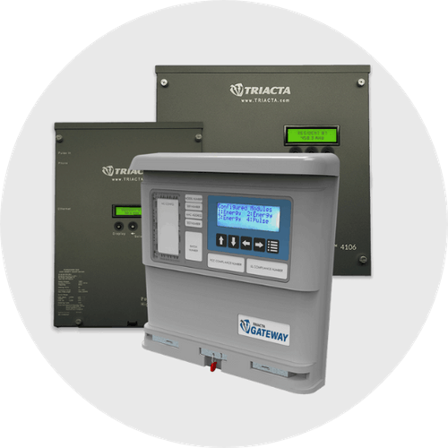
Why Energy Monitoring Matters
Submetering enables more accurate billing and tenant accountability
Energy data can expose inefficiencies and operational issues
Real-time visibility supports sustainability and cost-saving efforts
This analysis helps Metergy unlock deeper insight from interval data

Slide 4
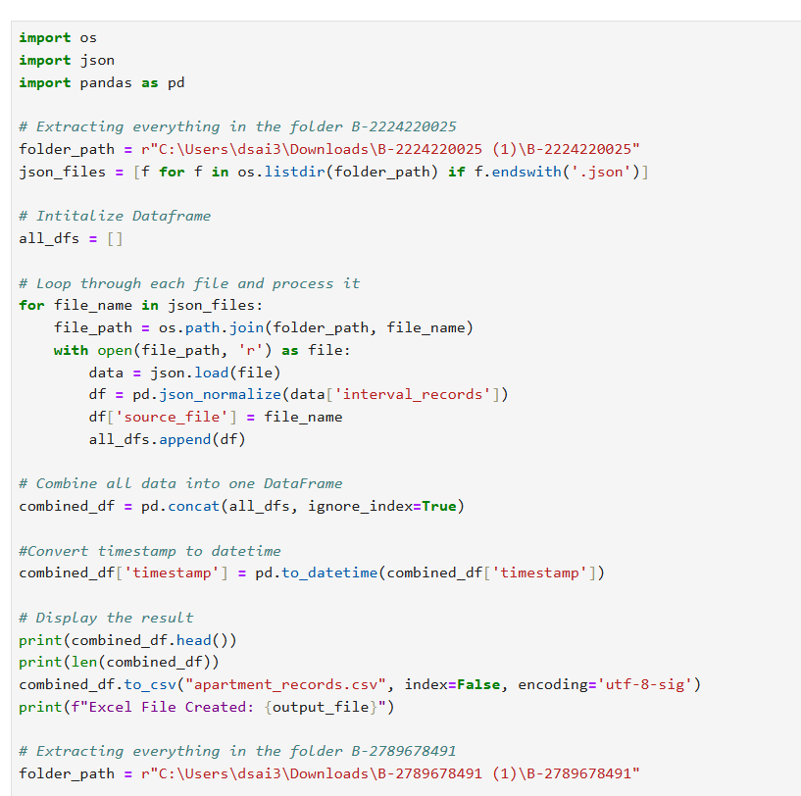
Data Setup and Processing
Data Source: JSON files parsed into Python
Cleaned and joined interval + register data
Timestamp processing to extract hour and weekday
Transferred all data into Python DataFrame
Exported to Excel and imported into Power BI

Slide 5
Key Metrics Tracked
kWh per interval: Core metric for analysis
Zero Readings: Count of intervals with exactly 0.0 kWh
Missing Days: Dates completely absent from interval data
Outliers: Measurements above 99.9th percentile
Peak Day/Hour: Times with highest average usage

Slide 6
Data Cleaning & Quality Checks
Timestamp Processing
Converted Unix and ISO timestamps into readable datetime format
Extracted hour and weekday to support time-based analysis
Missing Data Identification
Compared available dates against a full 30-day calendar using pd.date_range()
Found 25 days of valid interval data, 5 days missing entirely (6/7, 6/13, 6/14, 6/15, 6/16)
Zero Readings Detection
Isolated measurements with exactly 0.0 kW
Found 90 instances, mostly clustered during early morning hours
Outlier Detection
Flagged values above the 99.9th percentile as potential anomalies
Interval values at (0.52 - 0.56 kW)
Validation Summary
No null values or duplicates were found
Clean dataset supports reliable trend analysis and dashboard creation

Slide 7
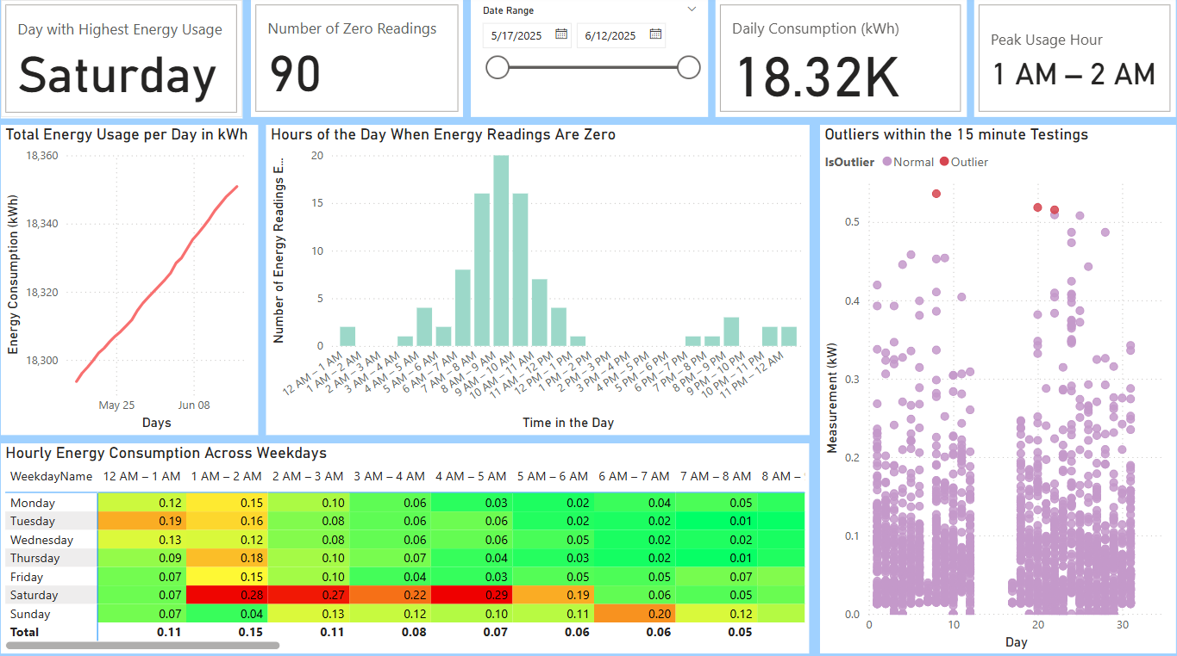

Slide 8
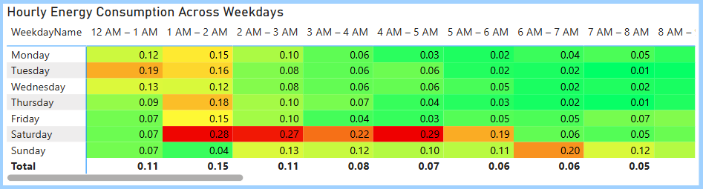
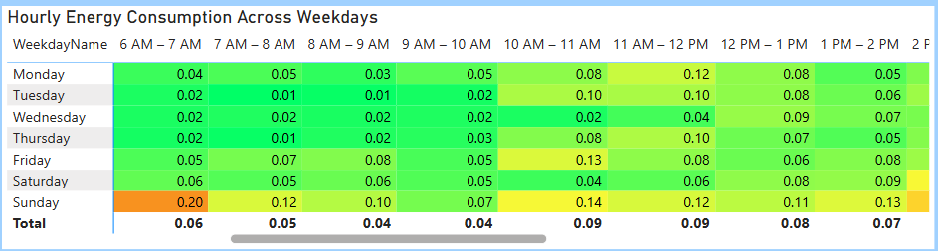
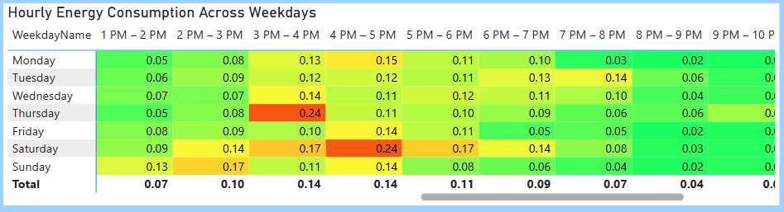
Analysis Results
Missing Data:
5 full days were missing from the 30-day interval dataset, reducing coverage to 25 days.
Zero Energy Readings:
90 zero kW readings were identified — most occurred between 8 AM and 9 AM, suggesting low activity or potential device downtime.
Outliers:
Several 15-minute intervals exceeded the 99.9th percentile threshold. These outliers may indicate HVAC spikes or irregular equipment behavior.
Peak Usage Times:
Day with highest average energy usage: Saturday
Hour with highest average usage: Midnight (typically 1–2 AM)
Consistent Daily Trends:
Most days followed a residential usage curve; low overnight (except Saturdays), peaking midday to evening.

Slide 9
Hidden Patterns in Energy Behavior
Zero Usage Concentration:
Of the 90 recorded zero kW readings, 72 occurred in May, with the majority concentrated on Tuesdays, Wednesdays, and Thursdays — pointing to a weekday-based pattern possibly linked to schedule or system downtime.
Peak Usage Window:
Across the dataset, 3–5 PM consistently emerged as the peak consumption period, regardless of the specific date range — indicating a strong behavioral trend in afternoon energy use.
Outlier Events:
Significant usage spikes were detected outside typical patterns, including:
Tuesday (12–1 AM) – overnight surge
Thursday (3–4 PM) – intensified afternoon load
Sunday (2–3 PM) – unusual weekend peak
These anomalies may suggest equipment surges, logging errors, or isolated high-demand activity.

Slide 10
Recommendations for Improved Energy Monitoring
Investigate Zero Readings: Review devices or occupancy patterns contributing to repeated 0 kW readings, especially between 7–9 AM.
Address Missing Data Days: Explore the root causes of the 5 missing days to prevent data loss in future collection cycles.
Review Outliers for Equipment Behavior: Examine high-usage spikes for possible HVAC surges, equipment faults, or operational anomalies.
Implement Ongoing Monitoring: Automate outlier and missing-data detection using threshold-based alerts in Power BI or a backend script.
Extend Dataset Scope: Analyze over longer periods (90-120 days) to detect seasonal usage shifts and improve forecasting models.

Slide 11
Future Work
Integrate weather and HVAC data for context
Neighborhood-Level Analysis
Predict Energy Usage with Machine Learning
Implement backend Python scripts to auto-flag anomalies
Build tenant-facing dashboards with personal usage summaries

Slide 12
Summary
Cleaned and analyzed interval energy data
Built Power BI visuals for anomaly and trend detection
Found usage peaks, outliers, and potential logging errors
Proposed actionable next steps for better energy monitoring
Tools and techniques are scalable to longer datasets and new buildings

Slide 13
Thank You / Q&A

